Slide 1
PROJECT TITLE
CAPSTONE PROJECT
Presented By:
Arshad Pasha
Seshadripuram Degree College
BCA Final Year

Slide 2
OUTLINE
Problem Statement (Should not include solution)
System Development Approach (Technology Used)
Algorithm & Deployment (Step by Step Procedure)
Result
Conclusion
Future Scope(Optonal)
References

Slide 3
Problem Statement
he project aims to predict whether an employee's annual salary exceeds $50,000 based on various demographic and employment-related features. In today's competitive job market, understanding salary patterns is crucial for both employers and employees for fair compensation decisions. Traditional manual salary assessment methods are time-consuming and may be biased. There is a need for an automated, data-driven approach to predict salary categories accurately. The challenge lies in identifying the most significant factors that influence high-income earnings and building a reliable prediction model. This project addresses the need for an intelligent system that can assist HR departments, job seekers, and policymakers in making informed decisions about compensation structures.

Slide 4
System Approach
The "System Approach" section outlines the overall strategy and methodology for developing and implementing the Employee Salary Prediction system.
System Requirements:
• Python 3.7 or higher
• Jupyter Notebook environment
• Minimum 4GB RAM for data processing
• Sufficient storage for dataset and model files
• Web browser for Streamlit application

Slide 5
System Approach
Libraries Required to Build the Model:
• pandas - Data manipulation and analysis
• matplotlib - Data visualization and plotting
• scikit-learn - Machine learning algorithms and preprocessing
• streamlit - Web application development
• joblib - Model serialization and saving
• numpy - Numerical computations (implicit dependency)

Slide 6
System Approach
Technology Stack:
• Programming Language: Python
• Development Environment: Jupyter Notebook
• Web Framework: Streamlit
• Machine Learning: Scikit-learn
• Data Processing: Pandas
• Visualization: Matplotlib

Slide 7
Algorithm & Deployment
tep-by-Step Procedure to Complete the Project:
1. Data Loading and Exploration:
- Load the adult.csv dataset using pandas
- Examine data structure with head(), tail(), and shape()
- Identify data types and missing values
2. Data Preprocessing:
- Handle missing values by replacing '?' with 'Others'
- Remove irrelevant categories ('Without-pay', 'Never-worked')
- Detect and remove outliers using boxplot visualization
- Filter age range (17-75 years) and education levels (5-16)

Slide 8
Algorithm & Deployment
3. Feature Engineering:
- Remove redundant features (education column)
- Apply Label Encoding to categorical variables:
* workclass, marital-status, occupation, relationship
* race, gender, native-country
4. Model Development:
- Split data into features (X) and target variable (y)
- Implement train-test split (80-20 ratio)
- Test multiple algorithms:
* Logistic Regression
* Random Forest Classifier
* K-Nearest Neighbors (KNN)
* Support Vector Machine (SVM)
* Gradient Boosting Classifier

Slide 9
Algorithm & Deployment
5. Model Evaluation:
- Compare accuracy scores across all models
- Generate classification reports
- Visualize model performance using bar charts
- Select best performing model
6. Model Deployment:
- Save the best model using joblib
- Create Streamlit web application (app.py)
- Implement user interface for single predictions
- Add batch prediction functionality
- Enable model downloading capabilities

Slide 10
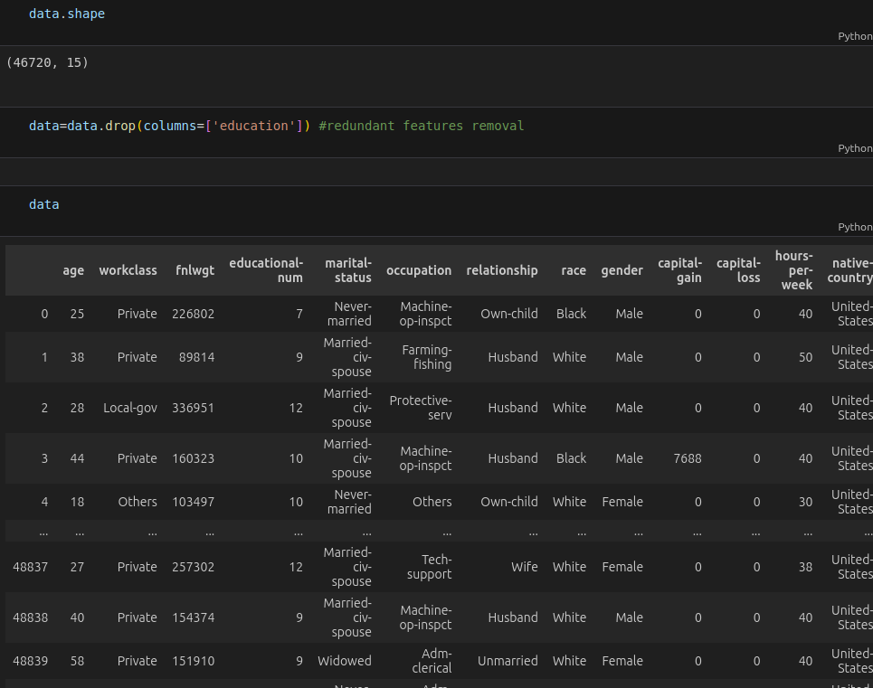
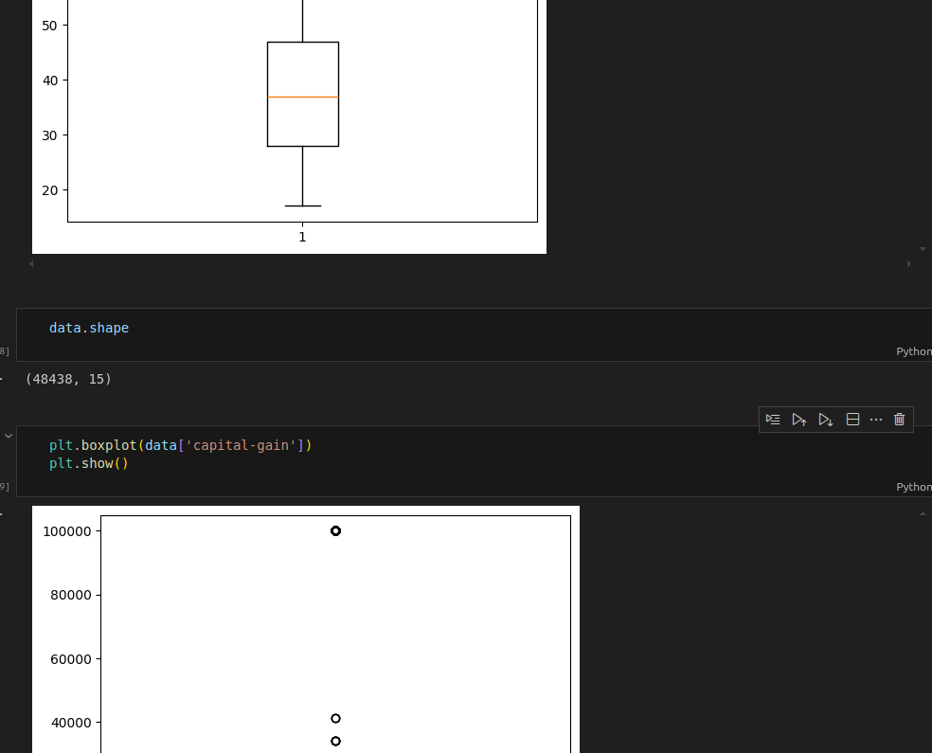
Result

Slide 11
Result
Attach your Github link
https://github.com/pashaarshad/AICTE-B2_AI--2025-26-/blob/main/Employee%20Salary%20Prediction/employee%20salary%20prediction.ipynb

Slide 12
Conclusion
The Employee Salary Prediction project successfully demonstrates the application of machine learning techniques for classification problems. The implemented solution effectively processes demographic and employment data to predict salary categories with reasonable accuracy. The automated model comparison approach ensures optimal algorithm selection, while the Streamlit deployment provides an accessible interface for end-users.

Slide 13
Future scope(Optional)
Potential enhancements and expansions for the system:
1. Advanced Feature Engineering:
• Include additional features like industry type, company size
• Implement feature selection techniques
• Add polynomial features for better model performance
2. Model Improvements:
• Implement ensemble methods combining multiple algorithms
• Add hyperparameter tuning using Grid Search or Random Search
• Incorporate deep learning models for complex pattern recognition

Slide 14
References
1. UCI Machine Learning Repository - Adult Data Set
https://archive.ics.uci.edu/ml/datasets/adult
2. Scikit-learn Documentation
https://scikit-learn.org/stable/
3. Streamlit Documentation
https://docs.streamlit.io/

Slide 15
THANK YOU
This capstone project demonstrates the complete machine learning pipeline from data preprocessing to model deployment, showcasing practical skills in data science and software development for real-world applications.

